Slide 1
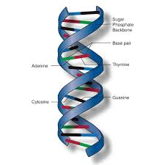
Genetic Algorithm and Its Applications
Samuel Lukas
Universitas Pelita Harapan

Slide 2
Introduction to Genetics Algorithm
Introduced by John Holland, Michigan University (1975). He stated that genetics algorithm can imitate evolution Darwin’s process by genetic operation of chromosome.
Population is a collection of chromosome in one time
Chromosome is an encodes of a possible solution to a problem
Offspring is a pair chromosome which is created by a pair of chromosome through crossover process
Generation is a next population after all chromosome have been processed fully (fitness calculation, Selection, Crossover and Mutation)

Slide 3
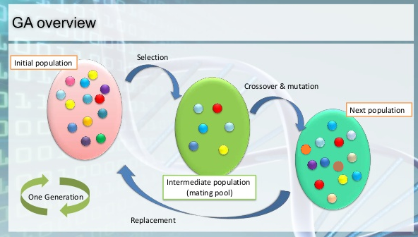
Genetic Algorithm Concept

Slide 4
Basic Algorithm of GA
Encodes of a possible solution to a problem
Produce an initial population of individuals
while termination condition not met do
evaluate the fitness of all individuals
select fitter individuals for reproduction
recombine between individuals
mutate individuals
generate a new population
End while
Interpret the best chromosome to solve the problem

Slide 5
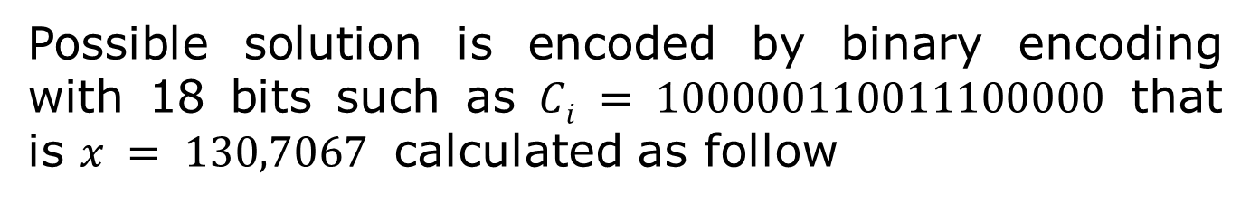
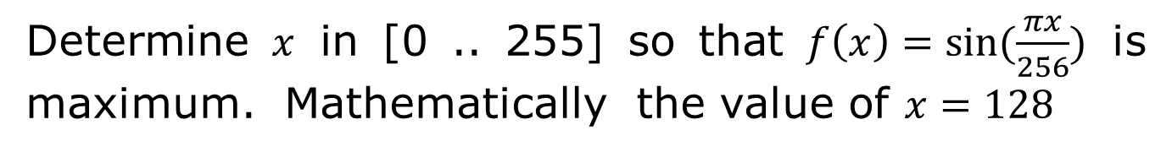
An Example
Determine $x$ in [0 .. 255] so that $f\left(x\right)=sin⁡(\frac{πx}{256})$ is maximum. Mathematically the value of $x=128$
Possible solution is encoded by binary encoding with 18 bits such as $Ci = 100000110011100000$ that is $x = 130,7067$ calculated as follow
(100000110011100000)₂ = (134368)₁₀
X = 255/(2¹⁸-1) * 134468 = 130,7067

Slide 6
First Population
# Chromosome | Form of Chromosome |  |  |  |  |  |  |  |  |  |  |  |  |  |  |  |  |  | X | fitness
1 | 1 | 0 | 1 | 0 | 0 | 1 | 1 | 0 | 1 | 1 | 0 | 0 | 0 | 0 | 0 | 1 | 1 | 1 | 166.106 | 0.892
2 | 1 | 1 | 0 | 0 | 1 | 0 | 0 | 0 | 1 | 1 | 1 | 1 | 0 | 0 | 1 | 1 | 1 | 0 | 200.167 | 0.632
3 | 0 | 0 | 0 | 0 | 0 | 1 | 0 | 1 | 0 | 0 | 1 | 0 | 1 | 1 | 0 | 1 | 1 | 0 | 5.158 | 0.063
4 | 0 | 0 | 1 | 0 | 0 | 0 | 1 | 0 | 0 | 1 | 1 | 0 | 1 | 1 | 0 | 0 | 0 | 0 | 34.288 | 0.409
5 | 0 | 1 | 0 | 1 | 1 | 0 | 0 | 1 | 0 | 1 | 0 | 0 | 1 | 1 | 0 | 1 | 0 | 1 | 88.953 | 0.888
6 | 0 | 0 | 1 | 1 | 0 | 0 | 0 | 1 | 0 | 1 | 0 | 1 | 0 | 1 | 0 | 0 | 1 | 0 | 49.138 | 0.567
7 | 1 | 0 | 0 | 1 | 0 | 0 | 0 | 0 | 1 | 0 | 1 | 1 | 0 | 1 | 0 | 0 | 0 | 0 | 144.138 | 0.980
8 | 1 | 1 | 0 | 1 | 0 | 0 | 0 | 1 | 0 | 0 | 0 | 0 | 0 | 1 | 0 | 0 | 1 | 0 | 208.202 | 0.553
9 | 1 | 0 | 1 | 0 | 0 | 1 | 1 | 0 | 1 | 0 | 0 | 1 | 0 | 1 | 1 | 1 | 0 | 1 | 165.941 | 0.893
10 | 0 | 1 | 0 | 0 | 0 | 1 | 1 | 0 | 0 | 1 | 1 | 0 | 1 | 0 | 0 | 0 | 0 | 0 | 70.131 | 0.758
11 | 1 | 1 | 0 | 1 | 0 | 1 | 1 | 0 | 0 | 1 | 0 | 0 | 1 | 1 | 0 | 0 | 1 | 1 | 213.464 | 0.498
12 | 1 | 1 | 1 | 0 | 1 | 0 | 0 | 1 | 0 | 1 | 0 | 1 | 1 | 1 | 0 | 0 | 0 | 1 | 232.450 | 0.284
13 | 0 | 1 | 0 | 0 | 1 | 1 | 1 | 0 | 1 | 0 | 0 | 1 | 0 | 0 | 0 | 1 | 1 | 1 | 78.263 | 0.820
14 | 1 | 1 | 1 | 1 | 0 | 0 | 0 | 0 | 0 | 0 | 0 | 1 | 1 | 1 | 0 | 0 | 0 | 1 | 239.173 | 0.204
15 | 0 | 0 | 0 | 1 | 1 | 1 | 1 | 0 | 0 | 1 | 1 | 1 | 0 | 1 | 1 | 0 | 0 | 1 | 30.343 | 0.364
16 | 1 | 1 | 0 | 0 | 1 | 0 | 1 | 1 | 1 | 0 | 0 | 0 | 1 | 1 | 0 | 1 | 1 | 0 | 202.758 | 0.607
17 | 0 | 0 | 0 | 0 | 1 | 1 | 0 | 1 | 0 | 1 | 0 | 1 | 0 | 1 | 1 | 1 | 1 | 0 | 13.290 | 0.162
18 | 1 | 1 | 0 | 1 | 0 | 1 | 1 | 1 | 0 | 1 | 0 | 1 | 0 | 1 | 0 | 0 | 1 | 0 | 214.490 | 0.487
19 | 1 | 0 | 1 | 1 | 1 | 0 | 1 | 0 | 0 | 1 | 1 | 0 | 0 | 1 | 0 | 0 | 0 | 0 | 185.663 | 0.759
20 | 1 | 1 | 1 | 0 | 0 | 0 | 1 | 0 | 0 | 0 | 0 | 1 | 0 | 0 | 0 | 1 | 1 | 0 | 225.186 | 0.368
Total Fitness |  |  |  |  |  |  |  |  |  |  |  |  |  |  |  |  |  |  |  | 11.189

Slide 7
Roulette Wheel Selection Process
# Chrom | fitrel | fitcum | Random number | New Chromosome
1 | 0.080 | 0.080 | 0.852 | 17
2 | 0.056 | 0.136 | 0.040 | 1
3 | 0.006 | 0.142 | 0.352 | 7
4 | 0.037 | 0.178 | 0.606 | 11
5 | 0.079 | 0.258 | 0.583 | 10
6 | 0.051 | 0.308 | 0.888 | 18
7 | 0.088 | 0.396 | 0.586 | 10
8 | 0.049 | 0.445 | 0.377 | 7
9 | 0.080 | 0.525 | 0.088 | 2
10 | 0.068 | 0.593 | 0.037 | 1
11 | 0.044 | 0.638 | 0.111 | 2
12 | 0.025 | 0.663 | 0.730 | 13
13 | 0.073 | 0.736 | 0.298 | 6
14 | 0.018 | 0.754 | 0.559 | 10
15 | 0.033 | 0.787 | 0.163 | 4
16 | 0.054 | 0.841 | 0.799 | 16
17 | 0.015 | 0.856 | 0.895 | 18
18 | 0.044 | 0.899 | 0.608 | 11
19 | 0.068 | 0.967 | 0.078 | 1
20 | 0.033 | 1.000 | 0.318 | 7

Slide 8
Temporary Population 1
,
,
,
# chrom | Form of Chromosome |  |  |  |  |  |  |  |  |  |  |  |  |  |  |  |  |  | X | fitness
1 | 0 | 0 | 0 | 0 | 1 | 1 | 0 | 1 | 0 | 1 | 0 | 1 | 0 | 1 | 1 | 1 | 1 | 0 | 13.290 | 0.162
2 | 1 | 0 | 1 | 0 | 0 | 1 | 1 | 0 | 1 | 1 | 0 | 0 | 0 | 0 | 0 | 1 | 1 | 1 | 166.106 | 0.892
3 | 1 | 0 | 0 | 1 | 0 | 0 | 0 | 0 | 1 | 0 | 1 | 1 | 0 | 1 | 0 | 0 | 0 | 0 | 144.138 | 0.980
4 | 1 | 1 | 0 | 1 | 0 | 1 | 1 | 0 | 0 | 1 | 0 | 0 | 1 | 1 | 0 | 0 | 1 | 1 | 213.464 | 0.498
5 | 0 | 1 | 0 | 0 | 0 | 1 | 1 | 0 | 0 | 1 | 1 | 0 | 1 | 0 | 0 | 0 | 0 | 0 | 70.131 | 0.758
6 | 1 | 1 | 0 | 1 | 0 | 1 | 1 | 1 | 0 | 1 | 0 | 1 | 0 | 1 | 0 | 0 | 1 | 0 | 214.490 | 0.487
7 | 0 | 1 | 0 | 0 | 0 | 1 | 1 | 0 | 0 | 1 | 1 | 0 | 1 | 0 | 0 | 0 | 0 | 0 | 70.131 | 0.758
8 | 1 | 0 | 0 | 1 | 0 | 0 | 0 | 0 | 1 | 0 | 1 | 1 | 0 | 1 | 0 | 0 | 0 | 0 | 144.138 | 0.980
9 | 1 | 1 | 0 | 0 | 1 | 0 | 0 | 0 | 1 | 1 | 1 | 1 | 0 | 0 | 1 | 1 | 1 | 0 | 200.167 | 0.632
10 | 1 | 0 | 1 | 0 | 0 | 1 | 1 | 0 | 1 | 1 | 0 | 0 | 0 | 0 | 0 | 1 | 1 | 1 | 166.106 | 0.892
11 | 1 | 1 | 0 | 0 | 1 | 0 | 0 | 0 | 1 | 1 | 1 | 1 | 0 | 0 | 1 | 1 | 1 | 0 | 200.167 | 0.632
12 | 0 | 1 | 0 | 0 | 1 | 1 | 1 | 0 | 1 | 0 | 0 | 1 | 0 | 0 | 0 | 1 | 1 | 1 | 78.263 | 0.820
13 | 0 | 0 | 1 | 1 | 0 | 0 | 0 | 1 | 0 | 1 | 0 | 1 | 0 | 1 | 0 | 0 | 1 | 0 | 49.138 | 0.567
14 | 0 | 1 | 0 | 0 | 0 | 1 | 1 | 0 | 0 | 1 | 1 | 0 | 1 | 0 | 0 | 0 | 0 | 0 | 70.131 | 0.758
15 | 0 | 0 | 1 | 0 | 0 | 0 | 1 | 0 | 0 | 1 | 1 | 0 | 1 | 1 | 0 | 0 | 0 | 0 | 34.288 | 0.409
16 | 1 | 1 | 0 | 0 | 1 | 0 | 1 | 1 | 1 | 0 | 0 | 0 | 1 | 1 | 0 | 1 | 1 | 0 | 202.758 | 0.607
17 | 1 | 1 | 0 | 1 | 0 | 1 | 1 | 1 | 0 | 1 | 0 | 1 | 0 | 1 | 0 | 0 | 1 | 0 | 214.490 | 0.487
18 | 1 | 1 | 0 | 1 | 0 | 1 | 1 | 0 | 0 | 1 | 0 | 0 | 1 | 1 | 0 | 0 | 1 | 1 | 213.464 | 0.498
19 | 1 | 0 | 1 | 0 | 0 | 1 | 1 | 0 | 1 | 1 | 0 | 0 | 0 | 0 | 0 | 1 | 1 | 1 | 166.106 | 0.892
20 | 1 | 0 | 0 | 1 | 0 | 0 | 0 | 0 | 1 | 0 | 1 | 1 | 0 | 1 | 0 | 0 | 0 | 0 | 144.138 | 0.980
Total Fitness |  |  |  |  |  |  |  |  |  |  |  |  |  |  |  |  |  |  |  | 13.691

Slide 9
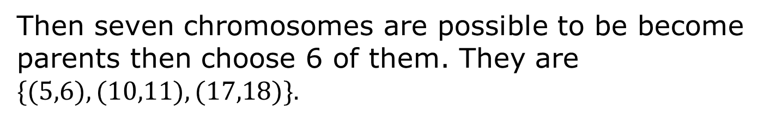
Crossover Process
Suppose Crossover probability is 0.25
number | Random number
1 | 0.383 | 0.475 | 0.849 | 0.851 | 0.125
6 | 0.209 | 0.968 | 0.462 | 0.481 | 0.112
11 | 0.241 | 0.597 | 0.908 | 0.807 | 0.961
16 | 0.497 | 0.062 | 0.106 | 0.051 | 0.857
Then seven chromosomes are possible to be become parents then choose 6 of them. They are $\{(5,6),(10,11),(17,18)\}.$

Slide 10
One Point Crossover Process
Since they are 18 gens in one chromosome, then for each pair of parent, generate one random number between 1 to 17,. Suppose the random number of (5,6) is 4 then
Old Parent’s Chromosome (5,6)
5 | 0 | 1 | 0 | 0 | 0 | 1 | 1 | 0 | 0 | 1 | 1 | 0 | 1 | 0 | 0 | 0 | 0 | 0 | 70.131 | 0.758
6 | 1 | 1 | 0 | 1 | 0 | 1 | 1 | 1 | 0 | 1 | 0 | 1 | 0 | 1 | 0 | 0 | 1 | 0 | 214.490 | 0.487
Offspring’s Chromosome (5,6)
5 | 0 | 1 | 0 | 0 | 0 | 1 | 1 | 1 | 0 | 1 | 0 | 1 | 0 | 1 | 0 | 0 | 1 | 0 | 71.052 | 0.766
6 | 1 | 1 | 0 | 1 | 0 | 1 | 1 | 0 | 0 | 1 | 1 | 0 | 1 | 0 | 0 | 0 | 0 | 0 | 213.570 | 0.497

Slide 11
Temporary Population 2
# chrom | Form of Chromosome |  |  |  |  |  |  |  |  |  |  |  |  |  |  |  |  |  | X | fitness
1 | 0 | 0 | 0 | 0 | 1 | 1 | 0 | 1 | 0 | 1 | 0 | 1 | 0 | 1 | 1 | 1 | 1 | 0 | 13.290 | 0.162
2 | 1 | 0 | 1 | 0 | 0 | 1 | 1 | 0 | 1 | 1 | 0 | 0 | 0 | 0 | 0 | 1 | 1 | 1 | 166.106 | 0.892
3 | 1 | 0 | 0 | 1 | 0 | 0 | 0 | 0 | 1 | 0 | 1 | 1 | 0 | 1 | 0 | 0 | 0 | 0 | 144.138 | 0.980
4 | 1 | 1 | 0 | 1 | 0 | 1 | 1 | 0 | 0 | 1 | 0 | 0 | 1 | 1 | 0 | 0 | 1 | 1 | 213.464 | 0.498
5 | 0 | 1 | 0 | 0 | 0 | 1 | 1 | 1 | 0 | 1 | 0 | 1 | 0 | 1 | 0 | 0 | 1 | 0 | 71.052 | 0.766
6 | 1 | 1 | 0 | 1 | 0 | 1 | 1 | 0 | 0 | 1 | 1 | 0 | 1 | 0 | 0 | 0 | 0 | 0 | 213.570 | 0.497
7 | 0 | 1 | 0 | 0 | 0 | 1 | 1 | 0 | 0 | 1 | 1 | 0 | 1 | 0 | 0 | 0 | 0 | 0 | 70.131 | 0.758
8 | 1 | 0 | 0 | 1 | 0 | 0 | 0 | 0 | 1 | 0 | 1 | 1 | 0 | 1 | 0 | 0 | 0 | 0 | 144.138 | 0.980
9 | 1 | 1 | 0 | 0 | 1 | 0 | 0 | 0 | 1 | 1 | 1 | 1 | 0 | 0 | 1 | 1 | 1 | 0 | 200.167 | 0.632
10 | 1 | 0 | 1 | 0 | 0 | 1 | 1 | 0 | 1 | 1 | 1 | 1 | 0 | 0 | 1 | 1 | 1 | 0 | 166.300 | 0.891
11 | 1 | 1 | 0 | 0 | 1 | 0 | 0 | 0 | 1 | 1 | 0 | 0 | 0 | 0 | 0 | 1 | 1 | 1 | 199.973 | 0.634
12 | 0 | 1 | 0 | 0 | 1 | 1 | 1 | 0 | 1 | 0 | 0 | 1 | 0 | 0 | 0 | 1 | 1 | 1 | 78.263 | 0.820
13 | 0 | 0 | 1 | 1 | 0 | 0 | 0 | 1 | 0 | 1 | 0 | 1 | 0 | 1 | 0 | 0 | 1 | 0 | 49.138 | 0.567
14 | 0 | 1 | 0 | 0 | 0 | 1 | 1 | 0 | 0 | 1 | 1 | 0 | 1 | 0 | 0 | 0 | 0 | 0 | 70.131 | 0.758
15 | 0 | 0 | 1 | 0 | 0 | 0 | 1 | 0 | 0 | 1 | 1 | 0 | 1 | 1 | 0 | 0 | 0 | 0 | 34.288 | 0.409
16 | 1 | 1 | 0 | 0 | 1 | 0 | 1 | 1 | 1 | 0 | 0 | 0 | 1 | 1 | 0 | 1 | 1 | 0 | 202.758 | 0.607
17 | 1 | 1 | 0 | 1 | 0 | 1 | 1 | 0 | 0 | 1 | 0 | 0 | 1 | 1 | 0 | 0 | 1 | 1 | 213.464 | 0.498
18 | 1 | 1 | 0 | 1 | 0 | 1 | 1 | 1 | 0 | 1 | 0 | 1 | 0 | 1 | 0 | 0 | 1 | 0 | 214.490 | 0.487
19 | 1 | 0 | 1 | 0 | 0 | 1 | 1 | 0 | 1 | 1 | 0 | 0 | 0 | 0 | 0 | 1 | 1 | 1 | 166.106 | 0.892
20 | 1 | 0 | 0 | 1 | 0 | 0 | 0 | 0 | 1 | 0 | 1 | 1 | 0 | 1 | 0 | 0 | 0 | 0 | 144.138 | 0.980
Total Fitness |  |  |  |  |  |  |  |  |  |  |  |  |  |  |  |  |  |  |  | 13.709

Slide 12
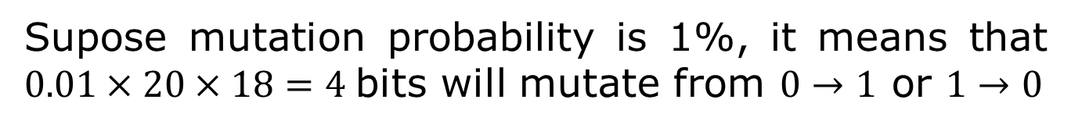
Mutation Process
Supose mutation probability is 1%, it means that $0.01×20×18=4$bits will mutate from $0→1$ or $1→0$
Create 360 random numbers from 1 to 360. It represents 360 available bits. Bit will mutate if the random number of that bit is less than 0.01.
If the 20th random number is 0.006 then bit number 20 will mutate. It means chromosome number 2 and bit number 2. Suppose the mutation bits are (2,2), (7,6), (11,9), (12,17), (13,1). Then the second generation is created

Slide 13
Second Generation
# chrom | Form of Chromosome |  |  |  |  |  |  |  |  |  |  |  |  |  |  |  |  |  | X | fitness
1 | 0 | 0 | 0 | 0 | 1 | 1 | 0 | 1 | 0 | 1 | 0 | 1 | 0 | 1 | 1 | 1 | 1 | 0 | 13.290 | 0.162
2 | 1 | 1 | 1 | 0 | 0 | 1 | 1 | 0 | 1 | 1 | 0 | 0 | 0 | 0 | 0 | 1 | 1 | 1 | 229.856 | 0.314
3 | 1 | 0 | 0 | 1 | 0 | 0 | 0 | 0 | 1 | 0 | 1 | 1 | 0 | 1 | 0 | 0 | 0 | 0 | 144.138 | 0.980
4 | 1 | 1 | 0 | 1 | 0 | 1 | 1 | 0 | 0 | 1 | 0 | 0 | 1 | 1 | 0 | 0 | 1 | 1 | 213.464 | 0.498
5 | 0 | 1 | 0 | 0 | 0 | 1 | 1 | 1 | 0 | 1 | 0 | 1 | 0 | 1 | 0 | 0 | 1 | 0 | 71.052 | 0.766
6 | 1 | 1 | 0 | 1 | 0 | 1 | 1 | 0 | 0 | 1 | 1 | 0 | 1 | 0 | 0 | 0 | 0 | 0 | 213.570 | 0.497
7 | 0 | 1 | 0 | 0 | 0 | 0 | 1 | 0 | 0 | 1 | 1 | 0 | 1 | 0 | 0 | 0 | 0 | 0 | 66.147 | 0.726
8 | 1 | 0 | 0 | 1 | 0 | 0 | 0 | 0 | 1 | 0 | 1 | 1 | 0 | 1 | 0 | 0 | 0 | 0 | 144.138 | 0.980
9 | 1 | 1 | 0 | 0 | 1 | 0 | 0 | 0 | 1 | 1 | 1 | 1 | 0 | 0 | 1 | 1 | 1 | 0 | 200.167 | 0.632
10 | 1 | 0 | 1 | 0 | 0 | 1 | 1 | 0 | 1 | 1 | 1 | 1 | 0 | 0 | 1 | 1 | 1 | 0 | 166.300 | 0.891
11 | 1 | 1 | 0 | 0 | 1 | 0 | 0 | 0 | 0 | 1 | 0 | 0 | 0 | 0 | 0 | 1 | 1 | 1 | 199.475 | 0.639
12 | 0 | 1 | 0 | 0 | 1 | 1 | 1 | 0 | 1 | 0 | 0 | 1 | 0 | 0 | 1 | 1 | 0 | 1 | 78.271 | 0.820
13 | 1 | 0 | 1 | 1 | 0 | 0 | 0 | 1 | 0 | 1 | 0 | 1 | 0 | 1 | 0 | 0 | 1 | 0 | 176.638 | 0.827
14 | 0 | 1 | 0 | 0 | 0 | 1 | 1 | 0 | 0 | 1 | 1 | 0 | 1 | 0 | 0 | 0 | 0 | 0 | 70.131 | 0.758
15 | 0 | 0 | 1 | 0 | 0 | 0 | 1 | 0 | 0 | 1 | 1 | 0 | 1 | 1 | 0 | 0 | 0 | 0 | 34.288 | 0.409
16 | 1 | 1 | 0 | 0 | 1 | 0 | 1 | 1 | 1 | 0 | 0 | 0 | 1 | 1 | 0 | 1 | 1 | 0 | 202.758 | 0.607
17 | 1 | 1 | 0 | 1 | 0 | 1 | 1 | 0 | 0 | 1 | 0 | 0 | 1 | 1 | 0 | 0 | 1 | 1 | 213.464 | 0.498
18 | 1 | 1 | 0 | 1 | 0 | 1 | 1 | 1 | 0 | 1 | 0 | 1 | 0 | 1 | 0 | 0 | 1 | 0 | 214.490 | 0.487
19 | 1 | 0 | 1 | 0 | 0 | 1 | 1 | 0 | 1 | 1 | 0 | 0 | 0 | 0 | 0 | 1 | 1 | 1 | 166.106 | 0.892
20 | 1 | 0 | 0 | 1 | 0 | 0 | 0 | 0 | 1 | 0 | 1 | 1 | 0 | 1 | 0 | 0 | 0 | 0 | 144.138 | 0.980
Total Fitness |  |  |  |  |  |  |  |  |  |  |  |  |  |  |  |  |  |  |  | 13.362

Slide 14

Last Generation (100)
# chrom | Form of Chromosome |  |  |  |  |  |  |  |  |  |  |  |  |  |  |  |  |  | X | fitness
1 | 1 | 0 | 0 | 1 | 1 | 0 | 0 | 0 | 0 | 1 | 0 | 0 | 1 | 0 | 0 | 0 | 1 | 0 | 151.689 | 0.958
2 | 1 | 0 | 0 | 1 | 0 | 0 | 0 | 0 | 0 | 1 | 0 | 0 | 1 | 0 | 0 | 0 | 1 | 1 | 143.721 | 0.981
3 | 1 | 0 | 0 | 1 | 1 | 0 | 0 | 1 | 0 | 1 | 0 | 0 | 1 | 1 | 0 | 0 | 1 | 0 | 152.701 | 0.954
4 | 1 | 0 | 0 | 0 | 1 | 0 | 0 | 0 | 0 | 1 | 0 | 0 | 1 | 1 | 0 | 0 | 0 | 0 | 135.765 | 0.995
5 | 1 | 0 | 0 | 1 | 1 | 0 | 0 | 0 | 0 | 1 | 0 | 0 | 1 | 1 | 0 | 0 | 1 | 0 | 151.704 | 0.958
6 | 1 | 0 | 0 | 1 | 1 | 0 | 0 | 1 | 0 | 1 | 0 | 0 | 1 | 1 | 0 | 0 | 1 | 0 | 152.701 | 0.954
7 | 1 | 0 | 0 | 1 | 1 | 0 | 1 | 0 | 0 | 1 | 0 | 0 | 1 | 1 | 0 | 0 | 1 | 1 | 153.698 | 0.950
8 | 1 | 0 | 0 | 1 | 1 | 0 | 0 | 0 | 0 | 0 | 1 | 0 | 1 | 1 | 0 | 0 | 1 | 0 | 151.580 | 0.958
9 | 1 | 0 | 0 | 1 | 1 | 0 | 1 | 0 | 0 | 1 | 0 | 0 | 1 | 0 | 0 | 0 | 1 | 1 | 153.682 | 0.951
10 | 1 | 0 | 0 | 1 | 1 | 0 | 0 | 0 | 0 | 1 | 0 | 0 | 1 | 1 | 0 | 0 | 0 | 0 | 151.703 | 0.958
11 | 1 | 0 | 0 | 1 | 1 | 0 | 1 | 0 | 0 | 1 | 0 | 0 | 1 | 1 | 0 | 1 | 1 | 1 | 153.702 | 0.950
12 | 1 | 0 | 0 | 1 | 1 | 0 | 0 | 0 | 0 | 1 | 0 | 0 | 1 | 1 | 0 | 0 | 1 | 0 | 151.704 | 0.958
13 | 1 | 0 | 1 | 1 | 1 | 0 | 0 | 0 | 0 | 1 | 0 | 0 | 1 | 1 | 0 | 0 | 1 | 0 | 183.580 | 0.776
14 | 1 | 0 | 0 | 1 | 1 | 0 | 0 | 0 | 0 | 1 | 0 | 0 | 1 | 1 | 0 | 0 | 1 | 1 | 151.705 | 0.958
15 | 1 | 0 | 0 | 1 | 1 | 0 | 1 | 0 | 0 | 1 | 0 | 0 | 1 | 0 | 0 | 0 | 1 | 1 | 153.682 | 0.951
16 | 1 | 0 | 0 | 1 | 1 | 0 | 0 | 0 | 0 | 1 | 0 | 0 | 0 | 1 | 0 | 0 | 1 | 0 | 151.673 | 0.958
17 | 1 | 0 | 0 | 1 | 1 | 0 | 0 | 0 | 0 | 1 | 0 | 0 | 1 | 1 | 0 | 0 | 1 | 0 | 151.704 | 0.958
18 | 1 | 0 | 0 | 1 | 1 | 0 | 0 | 0 | 0 | 1 | 0 | 0 | 1 | 1 | 0 | 0 | 1 | 0 | 151.704 | 0.958
19 | 1 | 0 | 0 | 1 | 1 | 0 | 0 | 0 | 0 | 0 | 0 | 0 | 1 | 1 | 0 | 0 | 1 | 0 | 151.455 | 0.959
20 | 1 | 0 | 0 | 1 | 1 | 0 | 1 | 0 | 0 | 1 | 0 | 0 | 1 | 0 | 0 | 0 | 1 | 1 | 153.682 | 0.951
Total Fitness |  |  |  |  |  |  |  |  |  |  |  |  |  |  |  |  |  |  |  | 18.992
$$x = 135.765 \& fitness=0.996$$

Slide 15
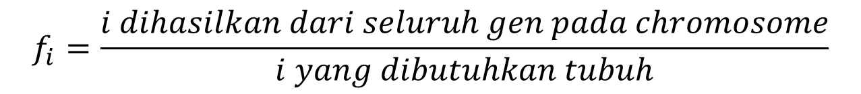
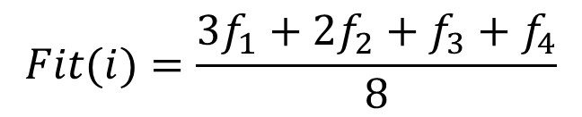
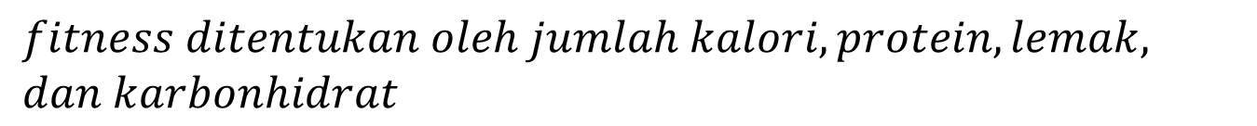
Case Problem 01
Komposisi Makanan Untuk Diet Dengan Algoritma Genetika
17 26 28 13 17 24 12 32 35 27 31 15 09 01
Gen : Code number of item food, stored in database
$$fitness ditentukan oleh jumlah kalori, protein,lemak,$$
$$dan karbonhidrat$$
$$Fit(i)=\frac{3f_{1}+2f_{2}+f_{3}+f_{4}}{8}$$
$$f_{i}=\frac{i dihasilkan dari seluruh gen pada chromosome}{i yang dibutuhkan tubuh}$$

Slide 16
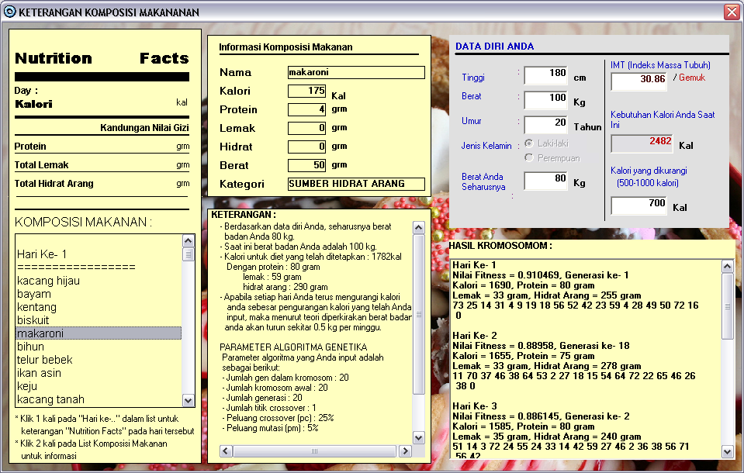
User Interface Of The System

Slide 17
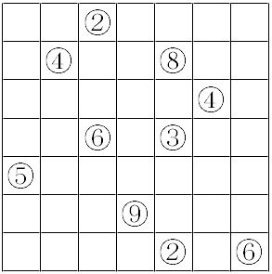
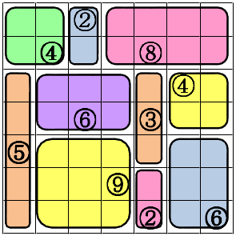
Case Problem 02
Implementation Of Heuristic technique and Genetic Algorithm in Shikaku puzzle Problem
Problem
Problem solved

Slide 18
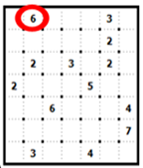
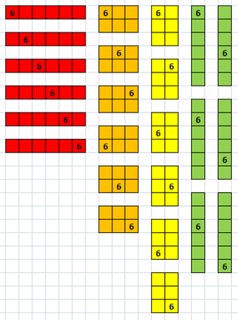
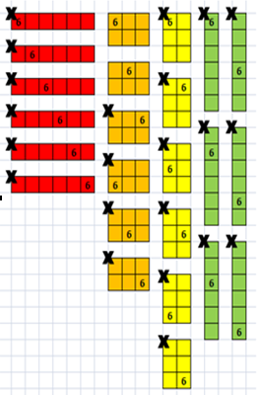
Heuristics Techniques
Heuristics search is applied
1. Find out a grid that has only one possible partition
2. If there is then draw that partition and recalculating all possible partitions
3 Go to step 1 until there is no grid has only one possible partition

Slide 19
Design of The System
A chromosome is a set of m gene that represents a code of possible partition of that position.
Fitness is defines as
A solution is a chromosome with
Single point crossover
Random point mutation

Slide 20
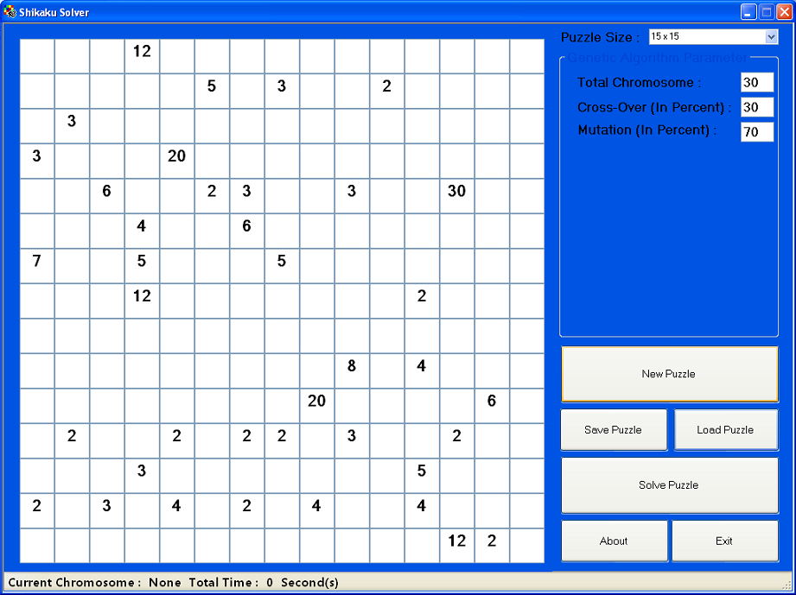
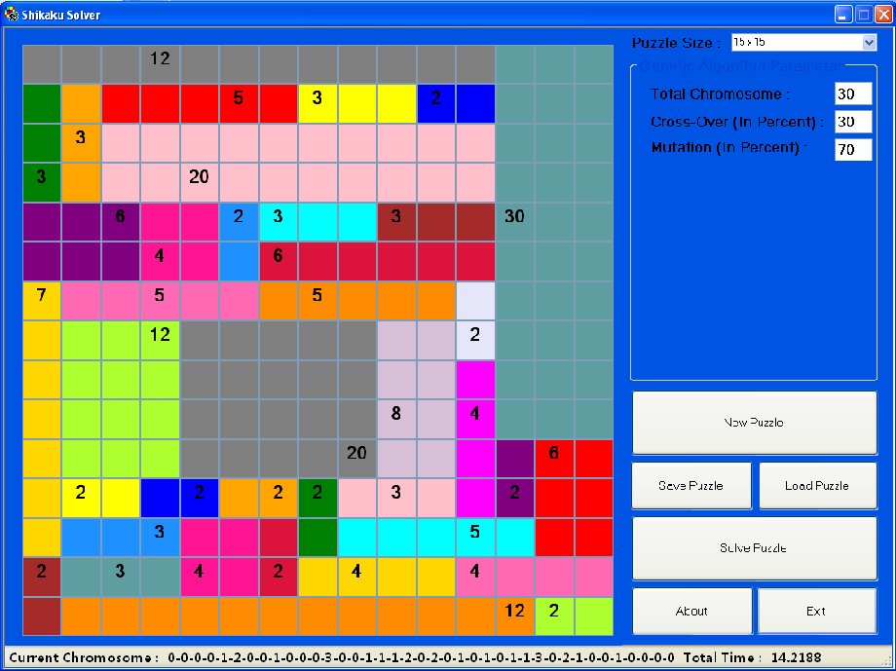
Implementation and Result

